Slide 1
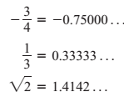
Mathematics Materials Lecturer A.M.Alazzawe FIRST CLASS
SEMESTER ONE
CHAPTER ONE
1.1 Real Numbers and the Real Line
This section reviews real numbers, inequalities, intervals, and absolute values.
Real Numbers: are numbers that can be expressed as decimals, such as
The real numbers can be represented geometrically as points on a number line called the real line.
THE ALGEBRAIC PROPERTIES
The real numbers can be added, subtracted, multiplied, and divided (except by 0) to produce more
real numbers under the usual rules of arithmetic.
There are three special subsets of real numbers.
1. The natural numbers, namely 1, 2, 3, 4
2. The integers, namely
3. The rational numbers, namely the numbers that can be expressed in the form of a fraction ,
where( m and n) are integers and n ≠ 0,
Examples are:
1

Slide 2
Mathematics Materials Lecturer A.M.Alazzawe FIRST CLASS
SEMESTER ONE
INTERVALS
❖ A subset of the real line is called an interval if it contains at least two numbers and contains
all the real numbers lying between any two of its elements. For example, the set of all x> 6
real numbers x such that is an interval. The set of all nonzero real numbers is not an interval;
since 0 is absent, the set fails to contain every real number between -1and 1 (for example).
EXAMPLE 1 : Solve the following inequalities and show their solution sets on the real line.
2

Slide 3
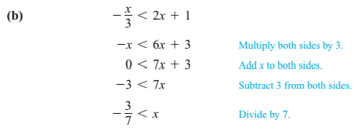
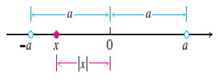
Mathematics Materials Lecturer A.M.Alazzawe FIRST CLASS
SEMESTER ONE
EXAMPLE : Illustrating the Triangle Inequality
The distance from (x to 0) is less than the positive number a. This means that x must lie between
(–a and a).
Absolute value
3

Slide 4
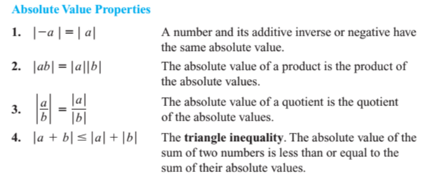
Mathematics Materials Lecturer A.M.Alazzawe FIRST CLASS
SEMESTER ONE
EXAMPLE: Solving an Equation with Absolute Values the equation | 2x -3| =7.
EXAMPLE: Solving an Inequality Involving Absolute Values Solve the inequality.
4

Slide 5
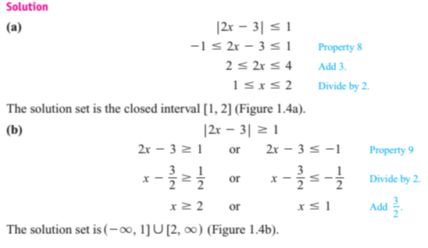
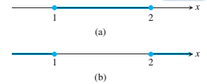
Mathematics Materials Lecturer A.M.Alazzawe FIRST CLASS
SEMESTER ONE
Solved Peroblems
5

Slide 6
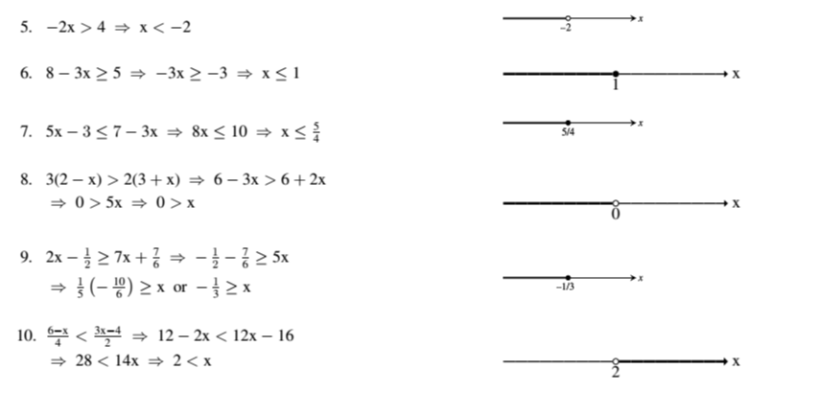
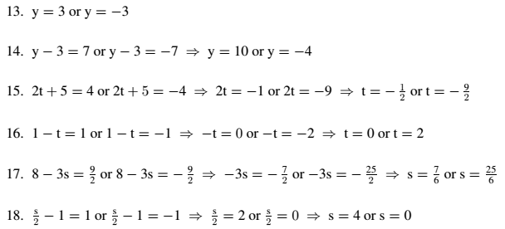
Mathematics Materials Lecturer A.M.Alazzawe FIRST CLASS
SEMESTER ONE
Solve the equations (Absolute Value)in Exercises
Solution
6

Slide 7
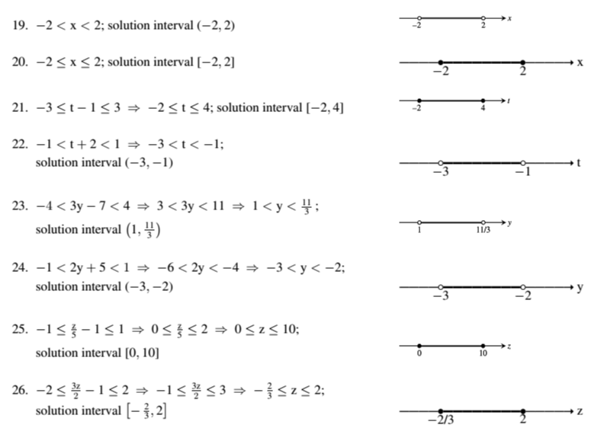
Mathematics Materials Lecturer A.M.Alazzawe FIRST CLASS
SEMESTER ONE
Exercises with solution
Solve the inequalities in Exercises 19–34, expressing the solution sets as intervals or unions of
intervals. Also, show each solution set on the real line.
Solution
Solve the inequalities in Exercises 35–42. Express the solution sets as intervals or unions of
intervals and show them on the real line.
7

Slide 8
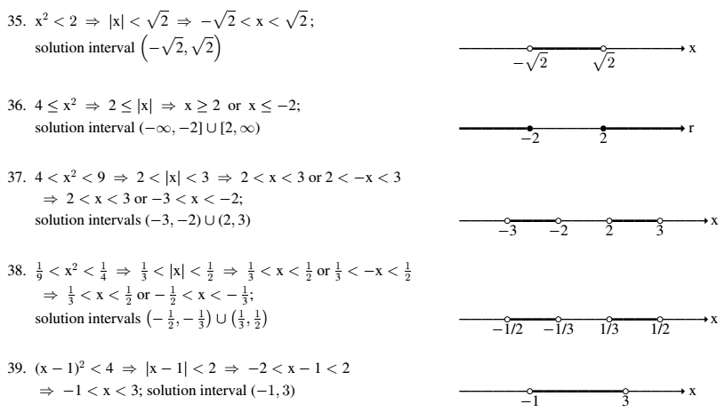
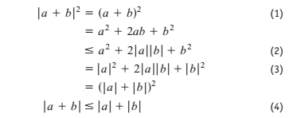
Mathematics Materials Lecturer A.M.Alazzawe FIRST CLASS
SEMESTER ONE
Tutorials
❖ proof of the triangle inequality Give the reason justifying each of the numbered steps in
the following proof of the triangle inequality.
❖
❖
❖
======================================================================
8

